Slide 1
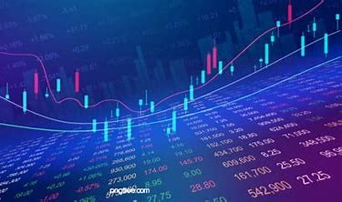
Stock Market Analysis
Presented by: (Group 1)
PEDDAPUTTAIAH GARI LAKSHMI KANTH REDDY
PIYUSH SUNIL SHIKOKARE
ABDUL RAHIMAN SHEIKH
DIKSHA YOGESH THORAT
SUNIL KUMAR MORRY
M SAI DINESH REDDY

Slide 2
CONTENT
INTRODUCTION
OBJECTIVES
WORKFLOW
TOOLS
DASHBOARDS
CHALLENGES
ADVANTAGES
CONCLUSION

Slide 3
INTRODUCTION
Stock market analysis is the process of evaluating market data, financial statements, and other relevant information to make informed investment decisions.
It involves studying various indicators, trends, and patterns to predict stock performance and identify potential opportunities or risks.
Leveraging a combination of Excel, SQL, Power BI, and Tableau, the project focuses on transforming raw data into meaningful and actionable insights.

Slide 4
OBJECTIVES
The objective of stock market analysis is to provide investors with a comprehensive understanding of the market, enabling them to make informed investment decisions.
This involves evaluating various market and economic factors to predict stock performance, identify potential opportunities and risks, and maximize returns while minimizing losses.
By identifying potential risks and opportunities, investors can adjust their investment strategies to minimize losses and maximize gains.

Slide 5
WORKFLOW
Step 1: Data Collection
Step 2: Data Cleaning and Preprocessing
Step 3: Segmentation
Step 4: Market Trend Analysis
Step 5: Fundamental Analysis
Step 6: Stock Screening
Step 7: Reporting and Visualization

Slide 6
TOOLS
Excel
Data cleaning, organization, and initial analysis using VLOOKUP, PivotTables, and Conditional Formatting.
SQL
Data extraction and manipulation with SELECT, WHERE, GROUP BY, and Date Functions.
Power BI
Created interactive dashboards with DAX, data modeling, and visualizations like charts, tables, and maps.
Tableau
Built dynamic dashboards using data blending, calculated fields, and interactive filters.

Slide 7

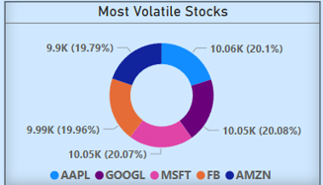
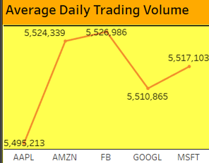
KPI’S
1.Average Daily Trading Volume:
2.Most volatile stocks:
The Average Daily Trading Volume (ADTV) is a key performance indicator (KPI) that measures the average number of shares traded in a security over a given period, typically a day.
The most volatile stocks are typically those with high daily price movements and significant price swings over short periods.

Slide 8
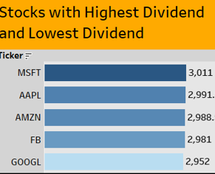
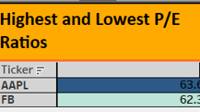
3.Stocks with Highest Dividend and Lowest Dividend:
4.Highest and Lowest P/E Ratios:
This KPI identifies the stocks with the highest and lowest dividend yields, which is the ratio of the annual dividend payment to the stock's current price.
The KPI "Highest and Lowest P/E Ratios" identifies the stocks with the highest and lowest P/E ratios in a given market or industry.

Slide 9
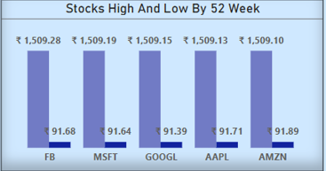
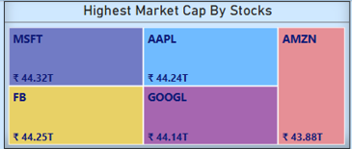
5.Stocks with Highest Market Cap:
6.Stocks Near 52 Week High and 52 Week Low:
Market capitalization (market cap) is the total value of a company's outstanding shares. The KPI "Stocks with Highest Market Cap" identifies the stocks with the largest market capitalization in a given market or industry.
The 52-week high and low prices are the highest and lowest prices a stock has traded at over the past 52 weeks.

Slide 10
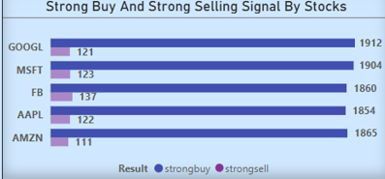
7.Stocks with Strong Buy Signals and stocks with Strong Selling Signal:
This KPI identifies stocks that have generated strong buy signals based on various technical and fundamental indicators.
By identifying stocks with strong buy or sell signals, investors can make more informed investment decisions.

Slide 11
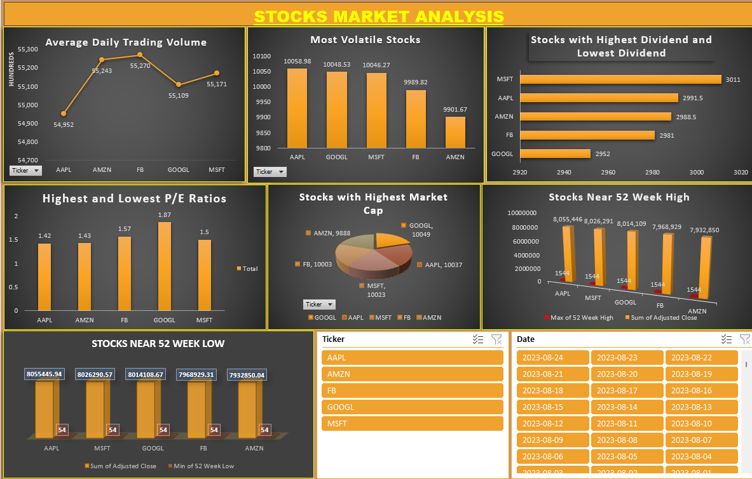
EXCEL

Slide 12
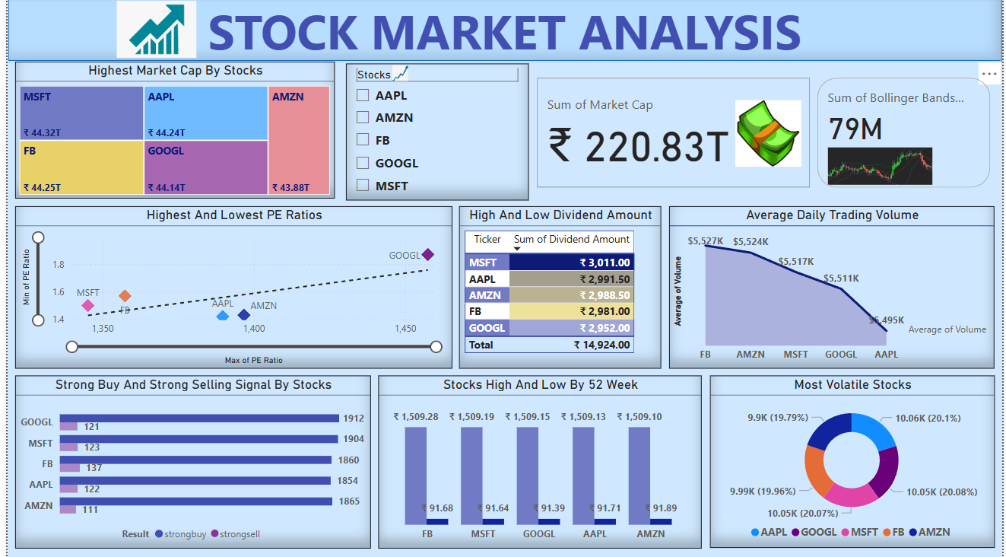
POWER BI

Slide 13
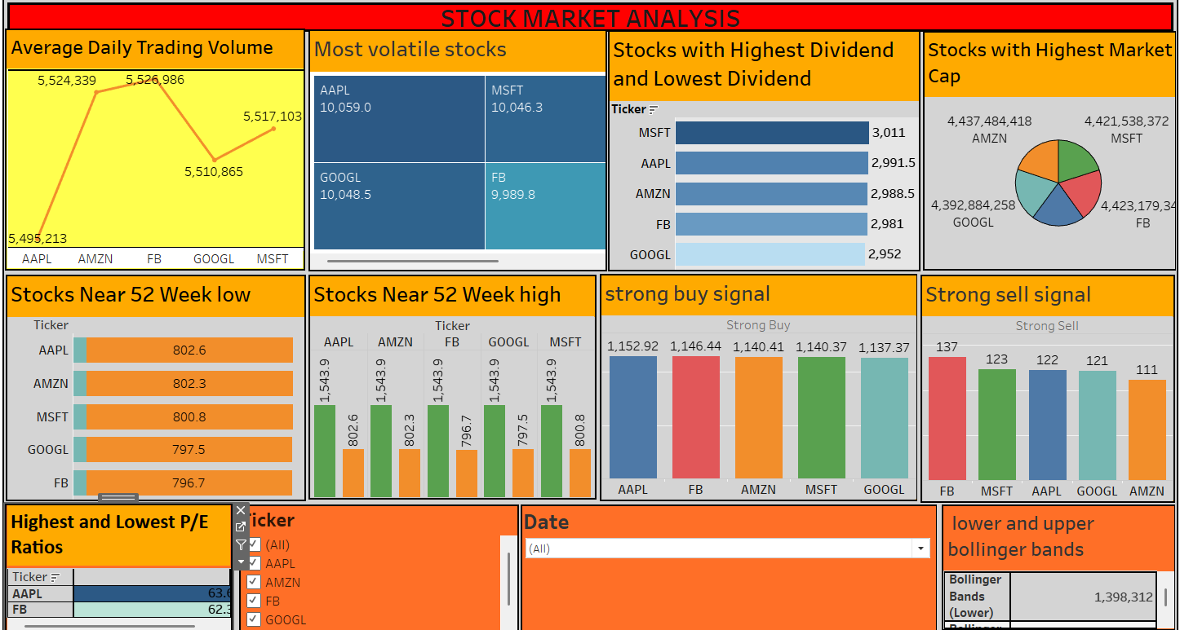
TABLEAU

Slide 14
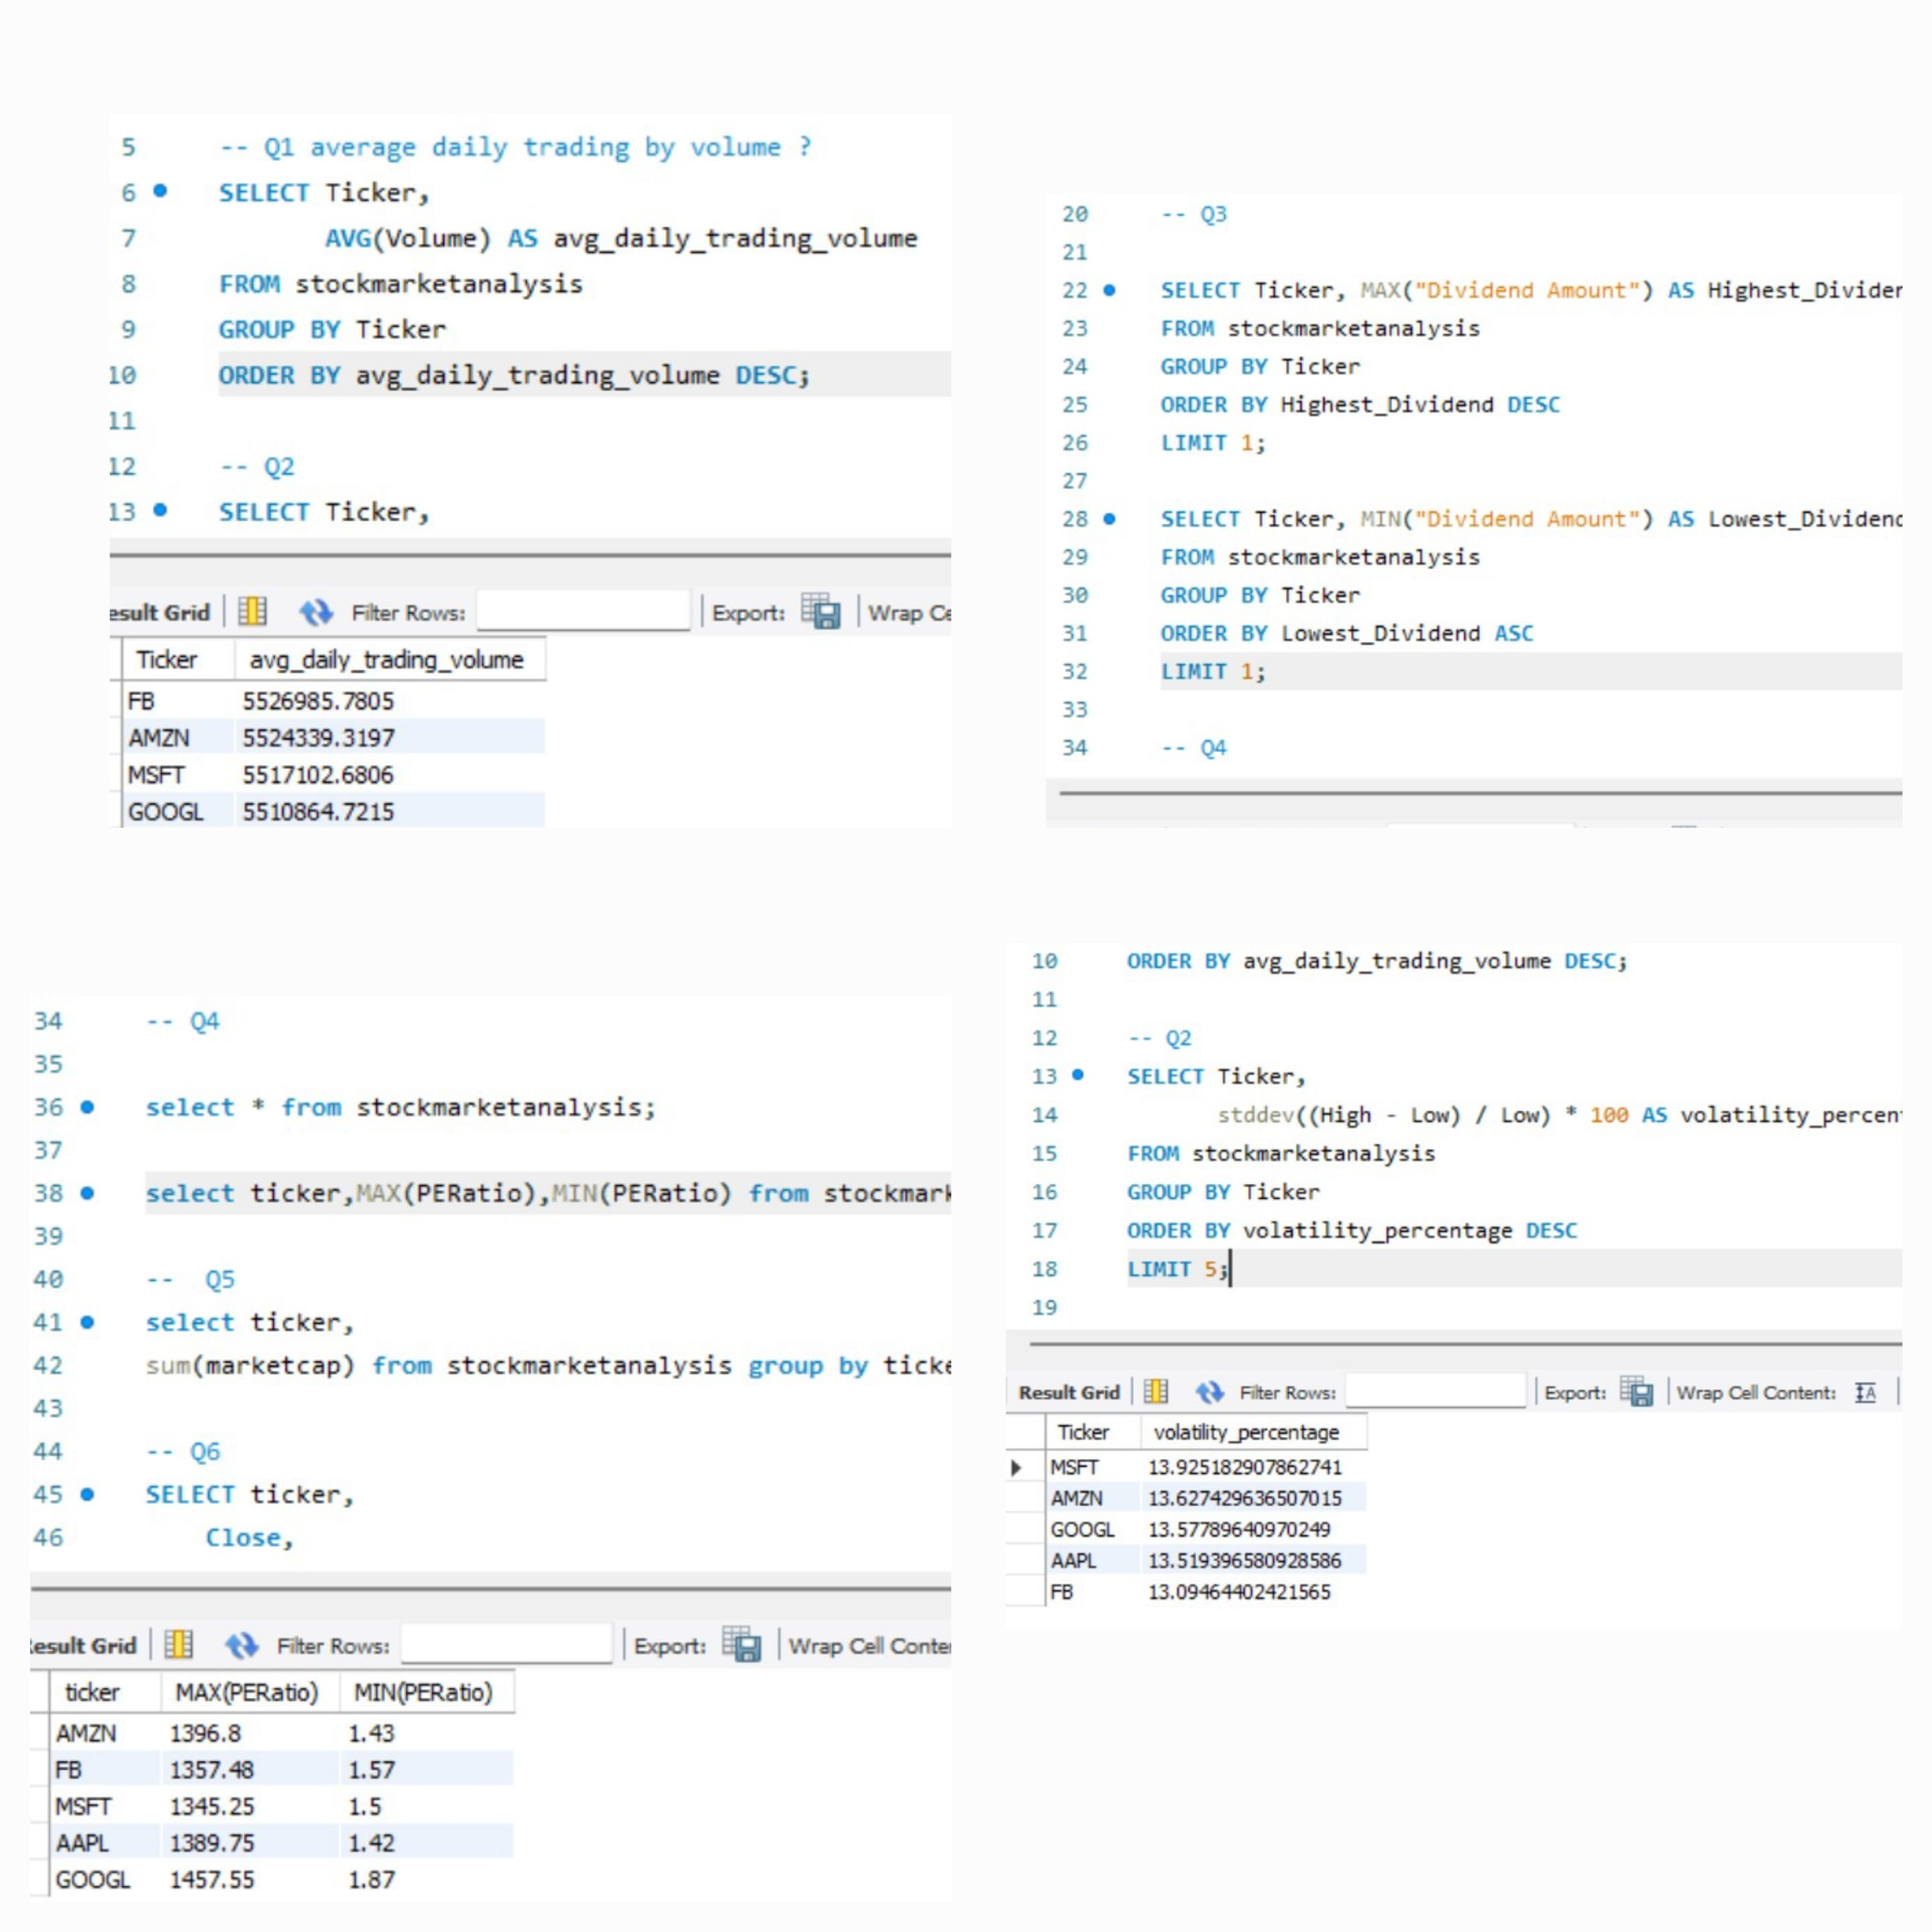
MYSQL

Slide 15
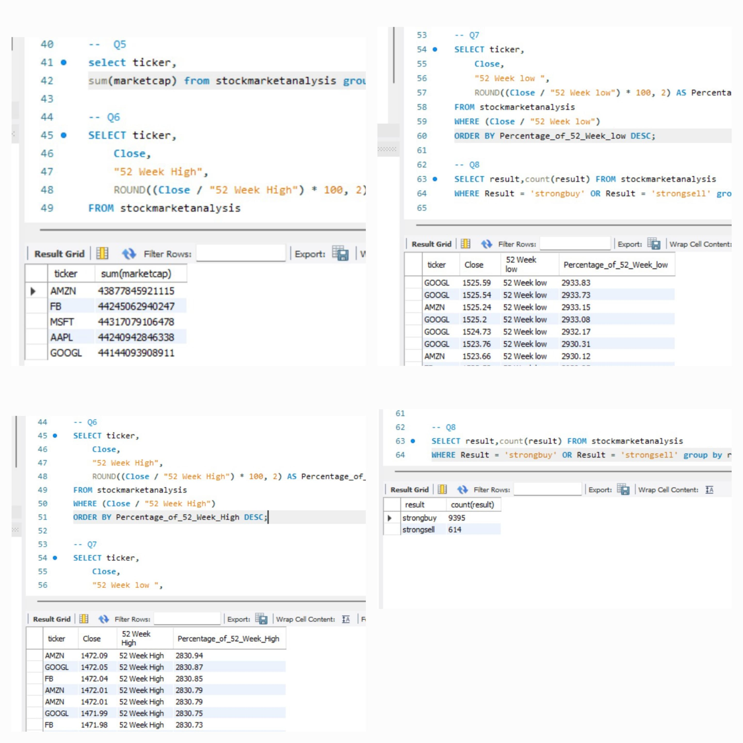
MYSQL

Slide 16
CHALLENGES
Data Quality Issues
Complex Queries
Understanding Relationships
Performance Issues
Visualization Complexity
Interpretation of Results
Time Management
Tool Proficiency

Slide 17
ADVANTAGES
Transparency and Regulation
Better Returns Over Time
Improved Portfolio Performance
Reduced Risk
Increased Confidence
Liquidity

Slide 18
CONCLUSION
By following this workflow, investors and analysts can conduct comprehensive stock market analysis and make data-driven investment decisions.
By applying the concepts, tools, and techniques of stock market analysis, investors can navigate the complexities of the stock market, make informed decisions, and achieve their investment objectives.

Slide 19
Thank you

